Slide 1
Multicast
CS425/CSE424/ECE428 – Distributed Systems – Fall 2011
Material derived from slides by I. Gupta, M. Harandi,
J. Hou, S. Mitra, K. Nahrstedt, N. Vaidya

Slide 2
Announcements
Groups for MPs
Two people
Must select by next week
Find a partner:
In class
On newsgroup
Email staff

Slide 3
Review Question 1
Consider the following vector timestamps
T1: [1,3,2]
T2: [2,4,2]
How do they compare:
A: T1 > T2
B: T1 < T2
C: T1 = T2
D: None of the above

Slide 4
Review Question 2
Which of these cuts is consistent?
A: 1 C: both
B: 2 D: neither
1
2

Slide 5
Communication Modes in DS
Unicast
One-to-one: Message from process p to process q.
Best effort: message may be delivered, but will be intact
Reliable: message will be delivered
Broadcast
One-to-all: Message from process p to all processes
Impractical for large networks
Multicast
One-to-many: “Local” broadcast within a group g of processes

Slide 6
Objectives
Define multicast properties
Reliability
Ordering
Examine algorithms for reliable and/or ordered multicast
Readings:
12.4 (4th ed), 15.4 (5th ed)
Optional: 4.5 (4th ed), 4.4 (5th ed)

Slide 7


Slide 8
Other Examples of Multicast Use
Akamai’s Configuration Management System (called ACMS) uses a core group of 3-5 servers. These servers continuously multicast to each other the latest updates. They use reliable multicast. After an update is reliably multicast within this group, it is then sent out to all the (1000s of) servers Akamai has all over the world.
Air Traffic Control System: orders by one ATC need to be ordered (and reliable) multicast out to other ATC’s.
Newsgroup servers multicast to each other in a reliable and ordered manner.

Slide 9
What’re we designing in this class
Application
One process p
(at process p)
send
multicast
deliver
multicast
MULTICAST PROTOCOL
Incoming
messages

Slide 10
Basic Multicast (B-multicast)
A straightforward way to implement B-multicast is to use a reliable one-to-one send (unicast) operation:
B-multicast(g,m): for each process p in g, send(p,m).
receive(m): B-deliver(m) at p.
Guarantees?
All processes in g eventually receive every multicast message…
… as long as send is reliable
… and no process crashes

Slide 11
Reliable Multicast
Integrity: A correct (i.e., non-faulty) process p delivers a message m at most once.
Agreement: If a correct process delivers message m, then all the other correct processes in group(m) will eventually deliver m.
Property of “all or nothing.”
Validity: If a correct process multicasts (sends) message m, then it will eventually deliver m itself.
Guarantees liveness to the sender.
Validity and agreement together ensure overall liveness: if some correct process multicasts a message m, then, all correct processes deliver m too.

Slide 12
Reliable R-Multicast Algorithm
On initialization
Received := {};
For process p to R-multicast message m to group g
B-multicast(g,m);
(p∈ g is included as destination)
On B-deliver(m) at process q with g = group(m)
if (m ∉ Received):
Received := Received ∪ {m};
if (q ≠ p):
B-multicast(g,m);
R-deliver(m)
R-multicast
“USES”
B-multicast
“USES”
reliable unicast

Slide 13
Reliable R-Multicast Algorithm
On initialization
Received := {};
For process p to R-multicast message m to group g
B-multicast(g,m);
(p∈ g is included as destination)
On B-deliver(m) at process q with g = group(m)
if (m ∉ Received):
Received := Received ∪ {m};
if (q ≠ p):
B-multicast(g,m);
R-deliver(m)
Integrity
Agreement
Validity

Slide 14
Ordered Multicast
FIFO ordering: If a correct process issues multicast(g,m) and then multicast(g,m’), then every correct process that delivers m’ will have already delivered m.
Causal ordering: If multicast(g,m) → multicast(g,m’) then any correct process that delivers m’ will have already delivered m.
Typically, → defined in terms of multicast communication only
Total ordering: If a correct process delivers message m before m’ (independent of the senders), then any other correct process that delivers m’ will have already delivered m.

Slide 15
Total, FIFO and Causal Ordering
Totally ordered messages T₁ and T₂.
FIFO-related messages F₁ and F₂.
Causally related messages C₁ and C₃
Causal ordering implies FIFO ordering
Total ordering does not imply causal ordering.
Causal ordering does not imply total ordering.
Hybrid mode: causal-total ordering, FIFO-total ordering.

Slide 16
Display From Bulletin Board Program
Bulletin board:
os.interesting
Item
From
Subject
23
A.Hanlon
Mach
24
G.Joseph
Microkernels
25
A.Hanlon
Re: Microkernels
26
T.L’Heureux
RPC performance
27
M.Walker
Re: Mach
end
What is the most appropriate ordering for this application?
(a) FIFO (b) causal (c) total

Slide 17
Providing Ordering Guarantees (FIFO)
Look at messages from each process in the order they were sent:
Each process keeps a sequence number for each other process.
When a message is received, if message # is:
as expected (next sequence), accept
higher than expected, buffer in a queue
lower than expected, reject

Slide 18
Implementing FIFO Ordering
S^{p}_{g}: the number of messages p has sent to g.
R^{q}_{g}: the sequence number of the latest group-g message p has delivered from q.
For p to FO-multicast m to g
p increments S^{p}_{g} by 1.
p “piggy-backs” the value S^{p}_{g} onto the message.
p B-multicasts m to g.
At process p, Upon receipt of m from q with sequence number S:
p checks whether S= R^{q}_{g}+1. If so, p FO-delivers m and increments R^{q}_{g}
If S > R^{q}_{g}+1, p places the message in the hold-back queue until the intervening messages have been delivered and S= R^{q}_{g}+1.

Slide 19
Hold-back Queue for Arrived Multicast Messages

Slide 20
Example: FIFO Multicast
Physical Time
Reject: 1 < 1 + 1
Accept: 2 = 1 + 1
P1
1 0 0
2 0 0
2 1 0
2 1 0
0 0 0
1
2
2
1
1
1
P2
0 0 0
1 0 0
2 0 0
2 1 0
Accept 1 = 0 + 1
Reject: 1 < 1 + 1
1
P3
0 0 0
0 0 0
1 0 0
2 1 0
2 0 0
Accept 1 = 0 + 1
2 0 0
Accept: 1 = 0 + 1
Buffer 2 > 0 + 1
Accept Buffer 2 = 1 + 1
0 0 0
Sequence Vector
(do NOT confuse with vector timestamps)
“Accept” = Deliver

Slide 21
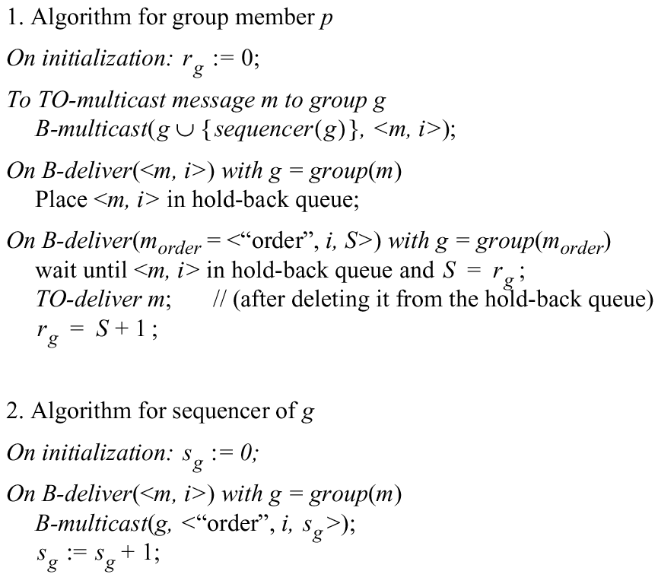
Total Ordering Using a Sequencer
Sequencer = Leader process

Slide 22
ISIS algorithm for total ordering
P
2
1 Message
3
2
P
2
2 Proposed Seq
4
1
3 Agreed Seq
1
2
P
1
3
P
3

Slide 23
ISIS algorithm for total ordering
Sender multicasts message to everyone
Reply with proposed priority (sequence no.)
Larger than all observed agreed priorities
Larger than any previously proposed (by self) priority
Store message in priority queue
Ordered by priority (proposed or agreed)
Mark message as undeliverable
Sender chooses agreed priority, re-multicasts message with agreed priority
Maximum of all proposed priorities
Upon receiving agreed (final) priority
Mark message as deliverable
Deliver any deliverable messages at front of priority queue

Slide 24
Example: ISIS algorithm
A
✔
✔
✔
A:1
A:2
C:2
C:3.3
P1
B:3.1
B:3
C
✔
✔
✔
P2
B:1
B:3.1
A:2
C:3
C:3.3
✔
✔
✔
P3
B:1
B:3
A:2
C:3.3
B:3.1
C:3
B

Slide 25
Proof of Total Order
For a message m₁, consider the first process p that delivers m₁
At p, when message m₁ is at head of priority queue and has been marked deliverable, let m₂ be another message that has not yet been delivered (i.e., is on the same queue or has not been seen yet by p)
finalpriority(m₂) >=
proposedpriority(m₂) >
finalpriority(m₁)
Suppose there is some other process p’ that delivers m₂ before it delivers m₁. Then at p’,
finalpriority(m₁) >=
proposedpriority(m₁) >
finalpriority(m₂)
a contradiction!
Due to “max” operation at sender
Since queue ordered by increasing priority
Due to “max” operation at sender
Since queue ordered by increasing priority

Slide 26
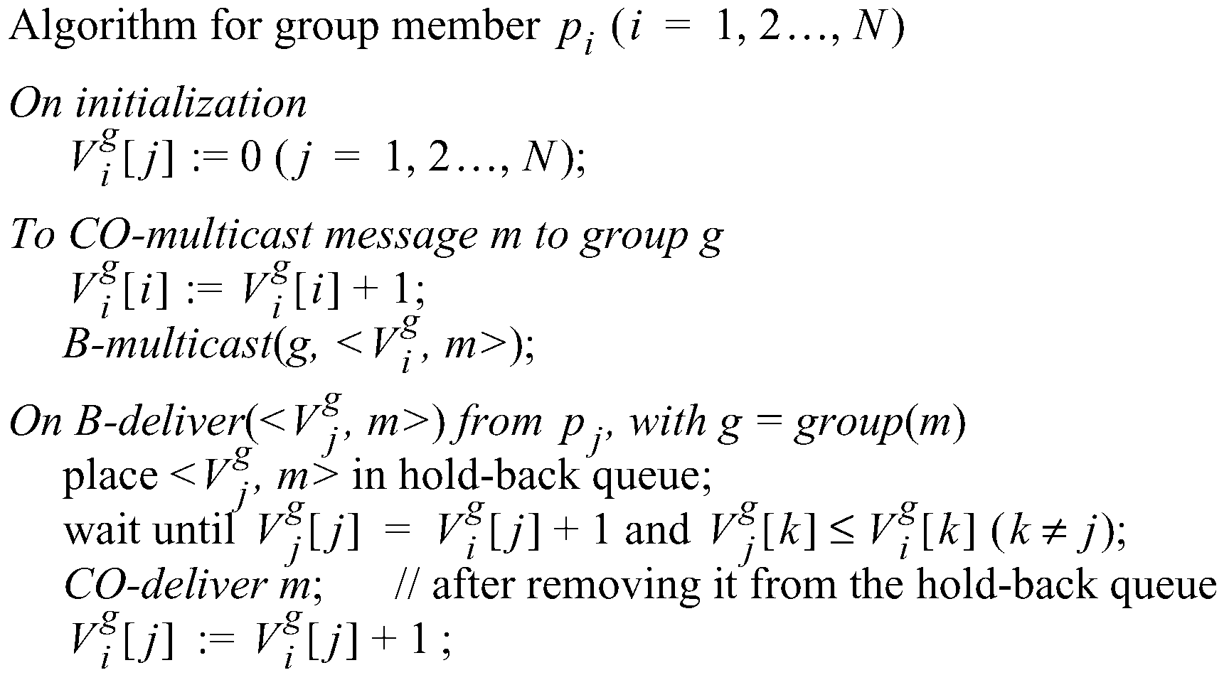
Causal Ordering using vector timestamps
The number of group-g messages
from process j that have been seen at
process i so far

Slide 27
Example: Causal Ordering Multicast
Reject:
Accept
P1
1,0,0
1,1,0
1,1,0
0,0,0
(1,0,0)
(1,1,0)
(1,1,0)
P2
0,0,0
1,0,0
1,1,0
(1,1,0)
(1,0,0)
P3
0,0,0
1,0,0
1,1,0
1,1,0
Accept
Accept:
Accept Buffered message
Buffer, missing P1(1)
Physical Time

Slide 28
Summary
Multicast is operation of sending one message to multiple processes in a given group
Reliable multicast algorithm built using unicast
Ordering – FIFO, total, causal

